Slide 1




MEDICAL RESEARCH ASSISTANT
Evidence-grounded answers from medical PDFs
Group 4
•Nishchay Linge Gowda
•Shivakumar Hassan Lokesh
•Supriya Singh
IE 5374 - Applied Generative AI

Slide 2



PROBLEM
Medical PDFs are long and difficult to navigate
Manual extraction of key information is slow
Users need quick, accurate answers backed by documents
Medical content demands precision and clear evidence

Slide 3

LIMITATIONS OF EXISTING METHODS
LLMs require structured, relevant context
Long documents exceed effective model limits
No automatic retrieval of important sections
Single-agent answers may be incomplete or inconsistent
No mechanism to cross-check medical accuracy

Slide 4



OUR SOLUTION
1. Structured PDF Processing
Extract → Chunk → Embed → Index
3. Three-Agent Reasoning Pipeline
Classification Agent – ensures PDF is medical
Generator Agent – drafts answer from retrieved chunks
Validator Agent – checks accuracy and refines answer
2. Fast Semantic Retrieval
FAISS retrieves only the most relevant PDF text
4. Evidence-Grounded Responses
Final answers strictly use information from uploaded medical PDFs

Slide 5
SYSTEM APPROACH
Document Preparation
Retrieval
Multi-Agent Reasoning
Extract, chunk, classify medical PDFs
Embed (Sentence-BERT)
Index with FAISS
Retrieve top-k relevant chunks per query
Generator agent → draft answer
Validator agent → accuracy + refinement
Return final answer

Slide 6
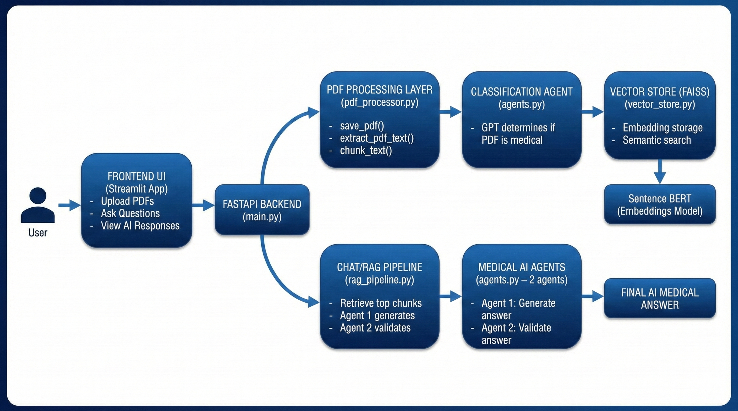
SYSTEM ARCHITECTURE

Slide 7

DOCUMENT PROCESSING PIPELINE
ABOUT US
save_pdf() → Save uploaded PDF
extract_pdf_text() → Extract raw text
chunk_text() → Split into meaningful segments
classification_agent() → Filter medical vs non-medical
Sentence-BERT embeddings → Represent chunks
save_pdf() → Save uploaded PDF
extract_pdf_text() → Extract raw text
chunk_text() → Split into meaningful segments
classification_agent() → Filter medical vs non-medical
Sentence-BERT embeddings → Represent chunks

Slide 8
Demo Flow
1
Upload medical PDFs
2
Ask question in Streamlit
3
FastAPI triggers RAG pipeline
4
FAISS retrieves relevant sections
5
Generator creates draft answer
6
Validator finalizes it
7
UI displays final medically-grounded output

Slide 9


Key Advantages of MedRAG
1. Evidence-Grounded by Design
2.⁠ ⁠Multi-Agent Verification Ensures Safety
Answers always cite retrieved medical text, avoiding unsupported model guesses
A second agent checks fidelity, consistency, and medical correctness before output.
3.⁠ ⁠Scales to Large Medical PDFs Effortlessly
4.⁠ ⁠Modular System Ready for Expansion
Semantic retrieval + FAISS enables fast navigation across long, dense documents.
New agents, better models, and advanced retrieval methods can be added easily.

Slide 10

Conclusion
CONCLUSION
Medical knowledge shouldn’t hide inside long PDFs — it should be accessible, accurate, and immediate
MedRAG brings structure, safety, and clarity to medical information retrieval.
FINAL TAKEAWAY
MedRAG shows that medical AI can be fast, trustworthy, and grounded in real documents — not guesses.

